Slide 1

Fake News Detection Model Using Machine Learning
The
Keyboard
Crackers⭐
Members:
Swopnil Adhikari
Anshu Subedi
Sudhan Adhikari
Anil Kumar Yadav
Combining NLP and Machine Learning for Media Integrity

Slide 2
Contents
Introduction
Significance………………………………………………………………………………………………………………………………….……..5
Objectives and Limitations
Objectives……………………………………………………………………………………………………………………..7
Limitations…………………………………………………………………………………………………………………….8
Literature Review……………………………………………………………………………………………………………………………..10
Model Development
Dataset……………………………………………………………………………………….…………………………………12
Model Training…………………………………………………………………………………….…………………...13
Implementation Workflow
Technologies Used…………………………………………………………………………………………….……15
Key Features……………………………………………………………………………………………………………….15
Hosting and Deployment………………………………………………………………………………………………….………..17
Results and Impact……………………………………………………………………………………………………………………….20
Future Enhancements………………………………………………………………………………………………………….………22
Conclusion………………………………………………………………………………………………………………………………………….24
References………………………………………………………………………………………………………….………………….25

Slide 3
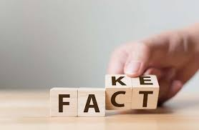
Introduction
Purpose: To develop a system that identifies and classifies news articles as either Real News or Fake News.
Utilizes Natural Language Processing (NLP) techniques.
Integrates a logistic regression classifier for predictions.
Python libraries used: pandas, scikit-learn, flask.
Builds a simple yet effective web interface.
Tackles misinformation in digital media.

Slide 4
01
Significance

Slide 5

Significance
Misinformation is a growing problem with serious societal and political implications.
A reliable detection system can mitigate the spread of fake news.
Enhances trust in media and digital content.
Difficulty in identifying fake news in large datasets.
Lack of tools for real-time detection of fake content.
Need for scalable, automated systems to ensure credibility.
Public trust erosion due to unchecked fake news proliferation.

Slide 6
02
Objectives and Limitations

Slide 7
2.1 Objectives
Focus on binary classification of news content.
Applicable for datasets in English language.
Intuitive user interface for non-technical users.
Uses logistic regression as the base model.
Modular design for integrating other classifiers.
Optical Character Recognition (OCR) for real-time scanning.

Slide 8
2.2 Limitations
Inconvenient for larger datasets with minor adjustments.
Logistic regression may not handle complex nuances.
Language support restricted to English.

Slide 9
03
Literature Review

Slide 10
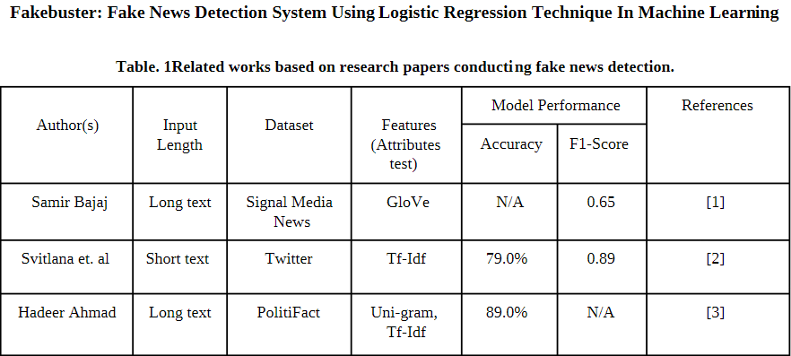
Literature Review
Hadeer Ahmad’s study used Uni-gram with TF-IDF, achieving 89.0% accuracy on a standard dataset.
Sivitlana's study combined logistic regression with TF-IDF, achieving 79.0% accuracy on real-world social media data.
Our research uses a hybrid model with logistic regression, TF-IDF, and OCR, achieving 98.3% accuracy.
Our study focuses on improving fake news detection by integrating OCR and a modular approach for scalability and future improvements.

Slide 11
04
Model Development

Slide 12
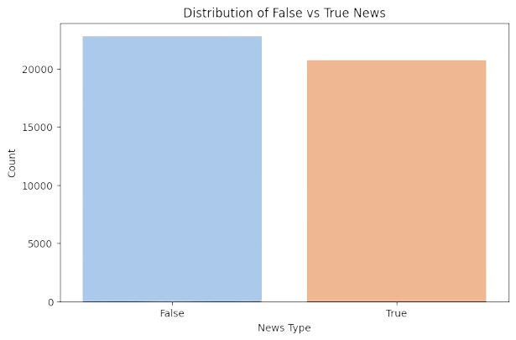
4.1 Dataset
Source: Kaggle True & Fake News Dataset
Structure:
Features: Title, Text, Source, etc.
Labels: 1 for Real News, 0 for Fake News
Preprocessing:
Removed null values.
Lowercased text.
Tokenized sentences and removed stopwords.

Slide 13
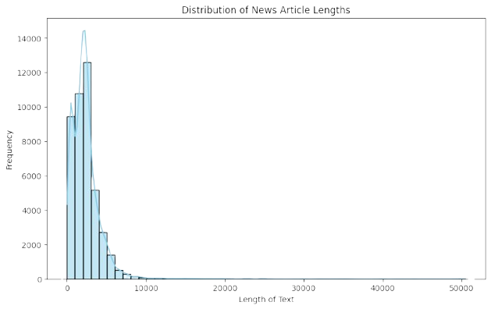
4.2 Model Training
Algorithm Used: Logistic Regression
Feature Extraction:
Used TF-IDF Vectorizer to convert textual data into numerical form.
Parameters tuned for optimal performance.
Evaluation Metrics:
Accuracy: 98% on test data.
Precision, Recall, F1-Score for balanced evaluation.

Slide 14
05
Implementation Workflow

Slide 15

5.1 Technologies Used
5.2 Key Features
Python Libraries: Scikit-learn, Pandas, NumPy, Flask, Streamlit, joblib.
Web Frameworks:
Streamlit for a simple, fast interface.
Flask for a customizable and robust web application.
Text Classification:
User inputs the news article.
Model predicts and displays results with confidence scores.
OCR Integration:
Real-time scanning and text extraction from images using Tesseract OCR.
UI/UX Enhancements:
Attractive animations using Lottie files.
Styled inputs and buttons with dynamic interactions.
Error handling for missing data or incorrect inputs.

Slide 16
06
Hosting and Deployment

Slide 17


Hosting And Development
Streamlit
Flask
Deployed using Streamlit Cloud for rapid prototyping.
Features include interactive buttons, real-time animations, and sidebar information.
Hosted on a local server for demonstration and scalable deployment.
Features include Bootstrap-based styling and support for REST API.

Slide 18
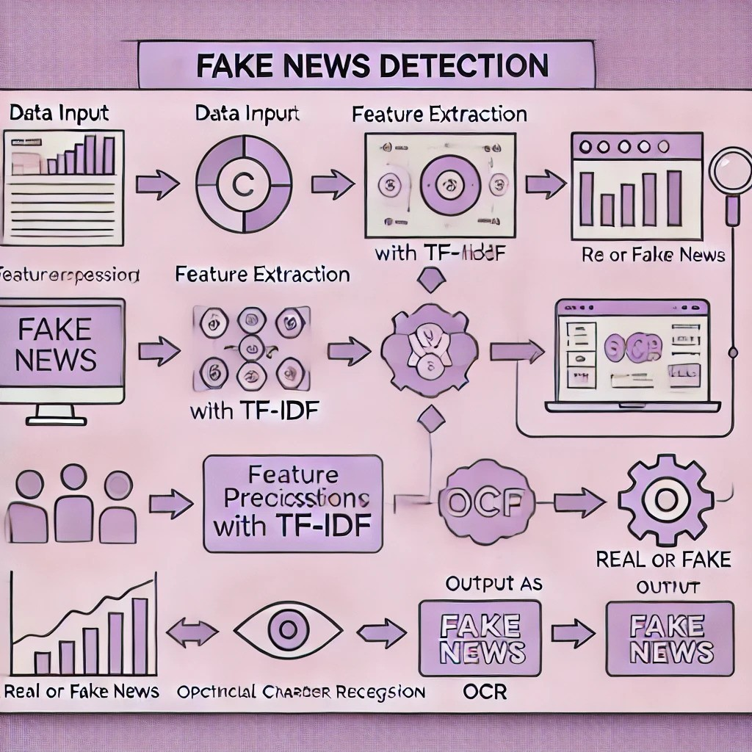

Slide 19
07
Results and Impact

Slide 20
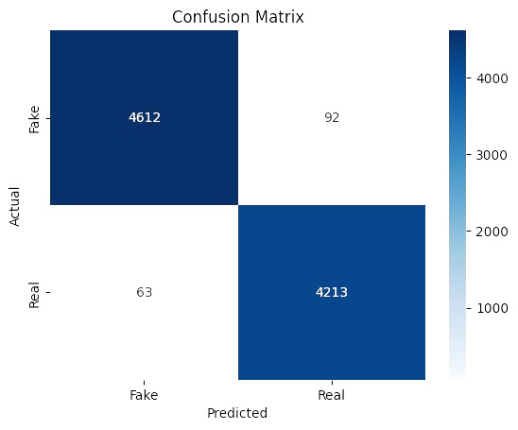
Results and Impact
Model Performance:
Achieved 98% accuracy on test data.
Reliable confidence scores for classification.
User Engagement:
Simple and appealing interfaces in both Streamlit and Flask.
Real-time classification boosts usability.
Potential Impact:
Helps individuals, organizations, and platforms combat fake news.
Promotes digital literacy and critical consumption of news.

Slide 21
08
Future Enhancements

Slide 22

Future Enhancements
Improved OCR: Incorporate advanced OCR models for better text recognition in noisy images.
Multilingual Support: Extend model capabilities to support news in multiple languages.
Deployment: Host on scalable platforms like AWS or Google Cloud for wider accessibility.
Explainability: Provide detailed explanations of why an article was classified as real or fake.

Slide 23
09
Conclusion

Slide 24

Conclusion
The Fake News Detection Project demonstrates the application of AI in solving real-world problems.
By combining advanced machine learning techniques with practical applications like OCR, it ensures versatility and accessibility.
The project addresses a critical need for combating misinformation in today's fast-paced digital world.
Encourages trust in technology by making AI solutions transparent and approachable for end-users.

Slide 25
References
Ahmad, H. (2018). Detecting Opinion Spam and Fake News Using N-gram Analysis and Semantic Similarity. Available at: http://dspace.library.uvic.ca:8080/bitstream/handle/1828/8796/Ahmed_Hadeer_Masc_2017.pdf?sequence=4
Oxford Dictionaries (2018). Fake | Definition of Fake in English. Available at: https://en.oxforddictionaries.com/definition/fake
Stroud, F. (2018). What Is Fake News? Webopedia Definition. Available at: https://www.webopedia.com/TERM/F/fake-news.html

Slide 26

Q&A Sessions?
And with that, we wrap up the presentation. Thank you all!

